Slide 1
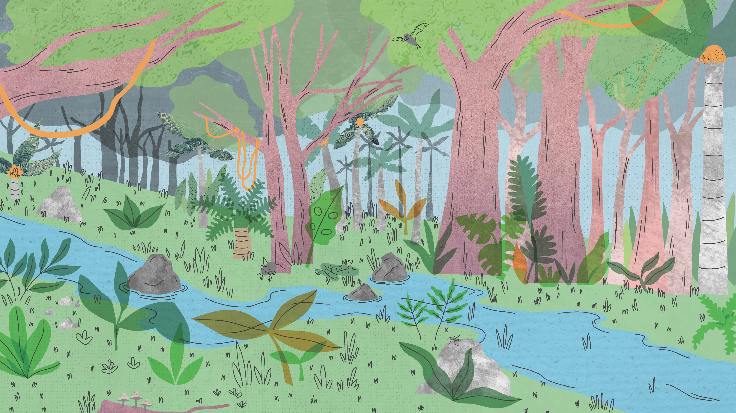

Health
gbif.org/health

Slide 2
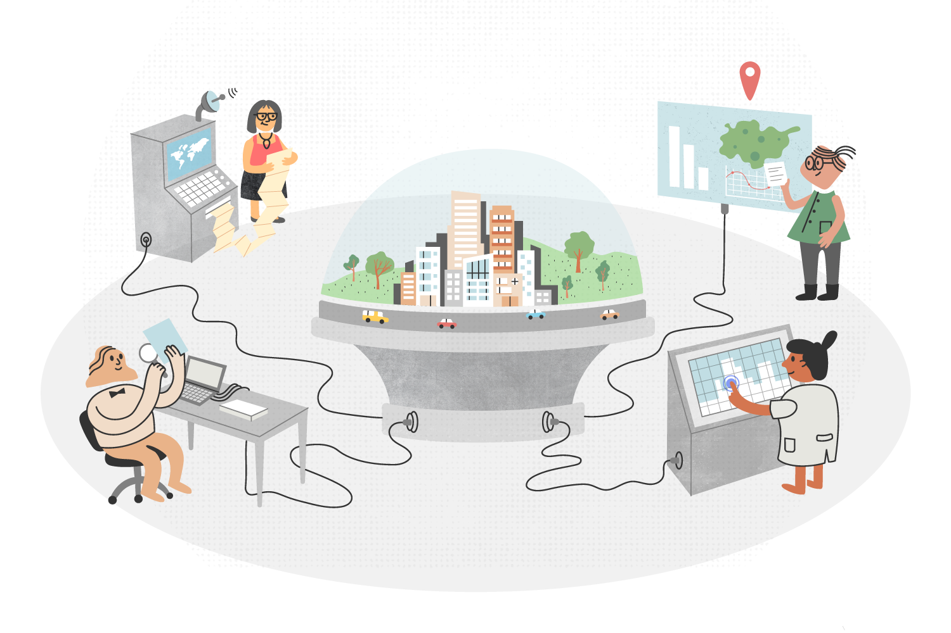
Health
Notes:
Text from postcard: By revealing where disease-causing pathogens occur, GBIF helps scientists and public health authorities recognize, manage and even prevent potential threats to human communities.

Slide 3
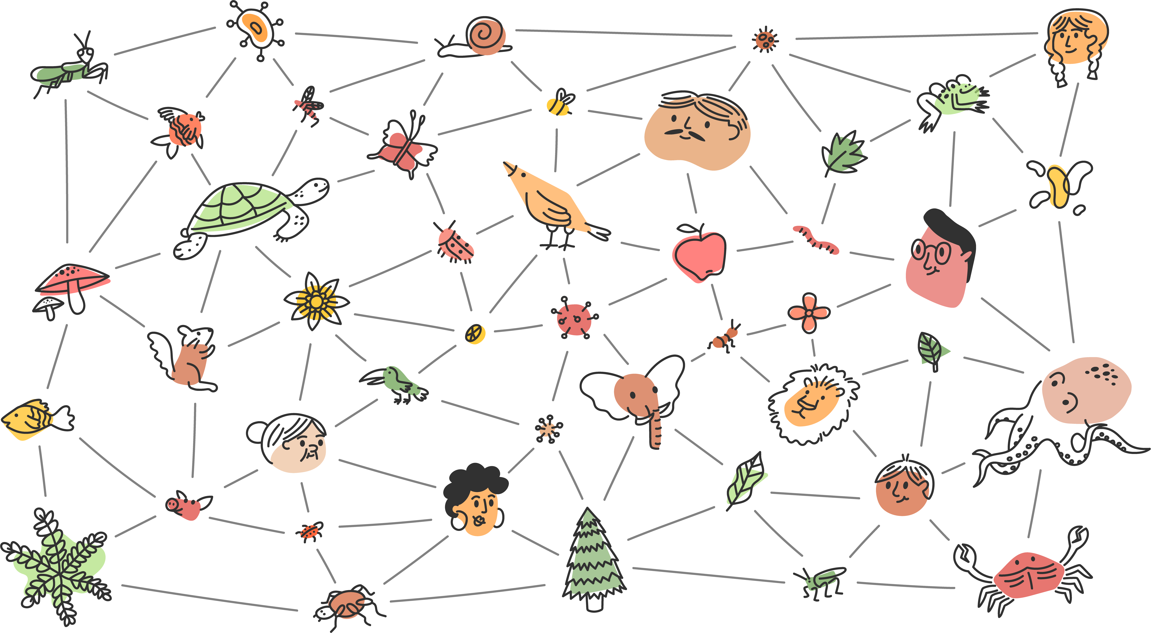
Health
GBIF connects biodiversity to human health by revealing where the wild species that serve as hosts, vectors and reservoirs of disease-causing pathogens impact human, animal and ecosystem health.
Notes:
Notes

Slide 4
Health
GBIF connects biodiversity to human health by revealing where the wild species that serve as hosts, vectors and reservoirs of disease-causing pathogens impact human, animal and ecosystem health.
While other organizations are responsible for handling disease-related data, GBIF plays its role in supporting One Health—a term that describes a collaborative, transdisciplinary approach recognizing the intimate connections between the well-being of humans, animals and ecosystems, from local to global scales.

Slide 5
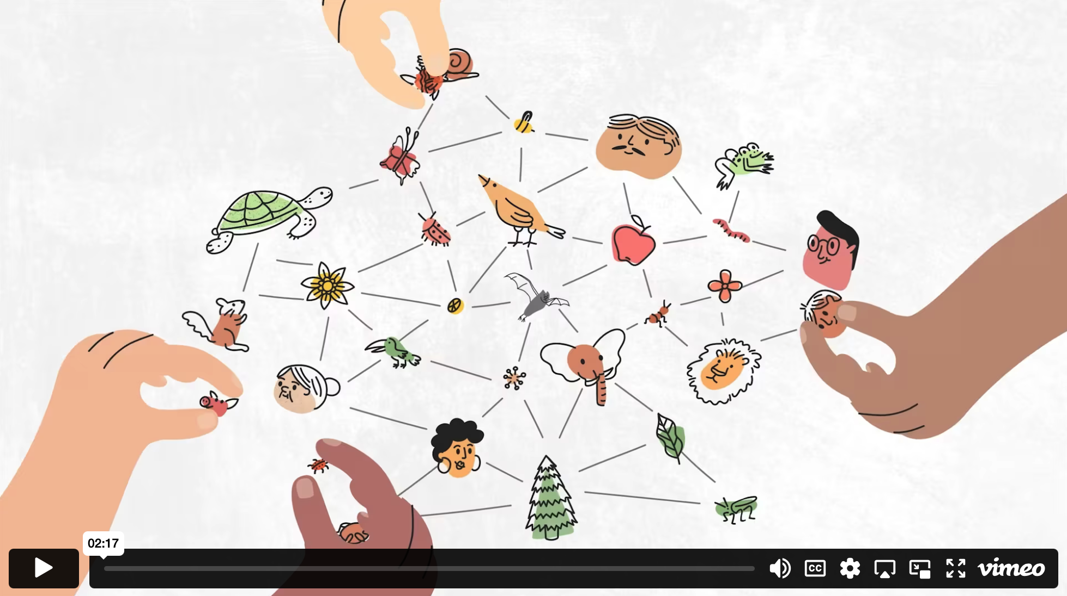
GBIF & health - Video

Slide 6
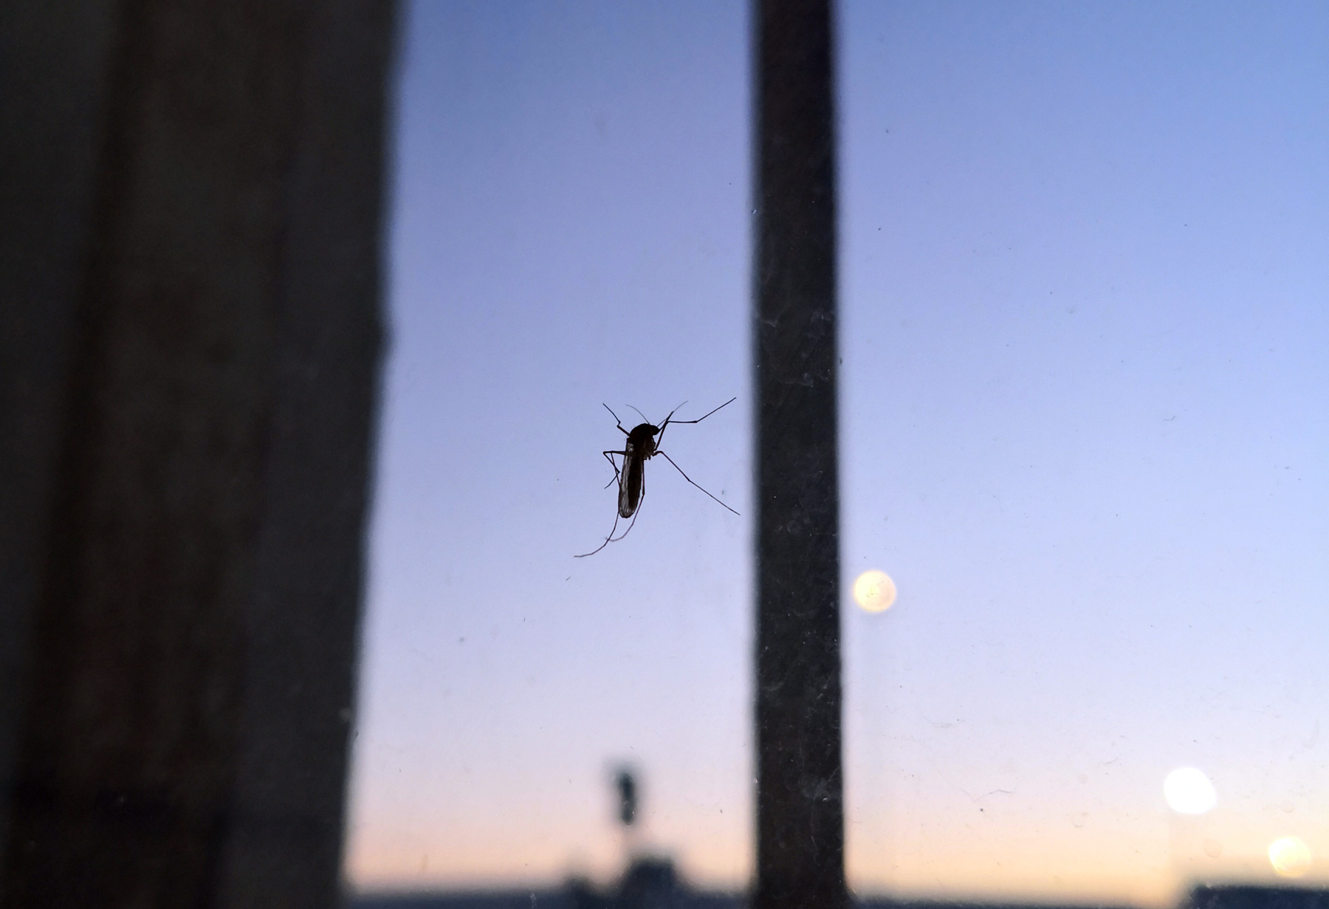
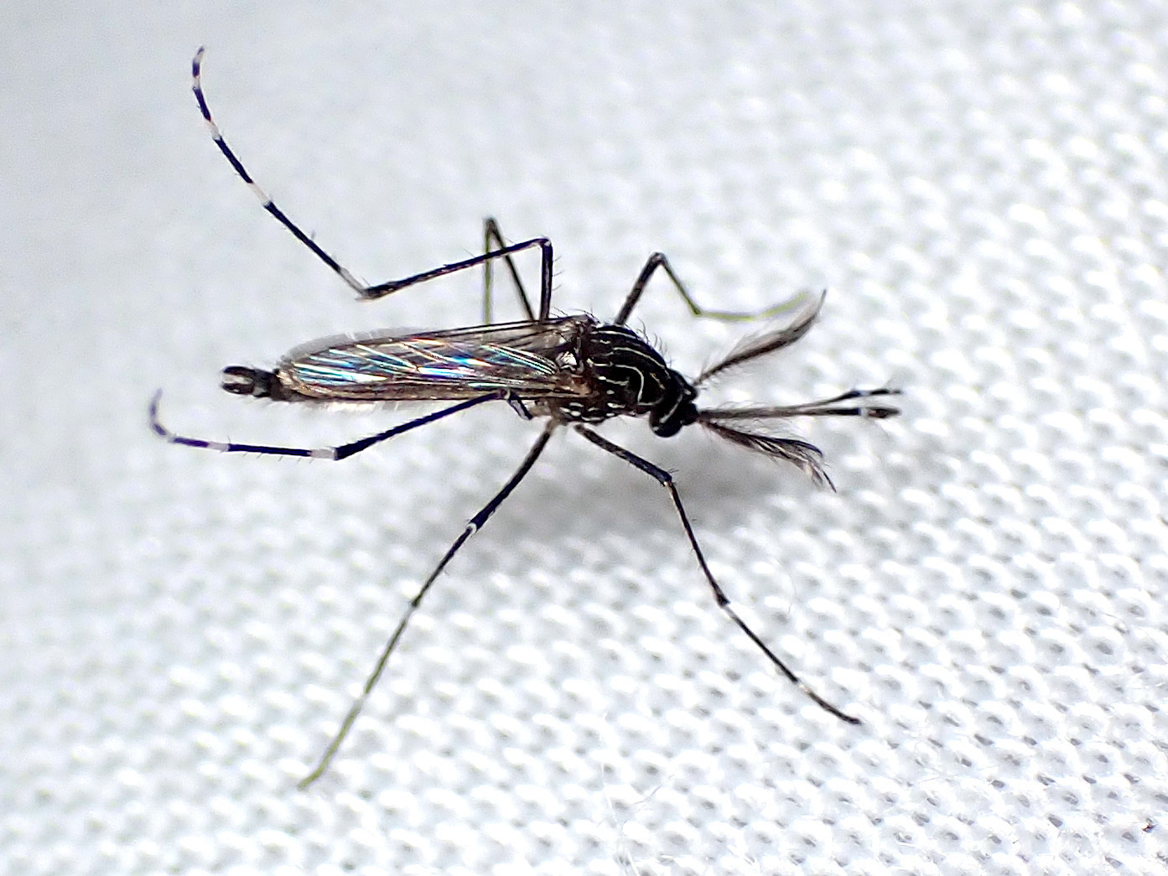
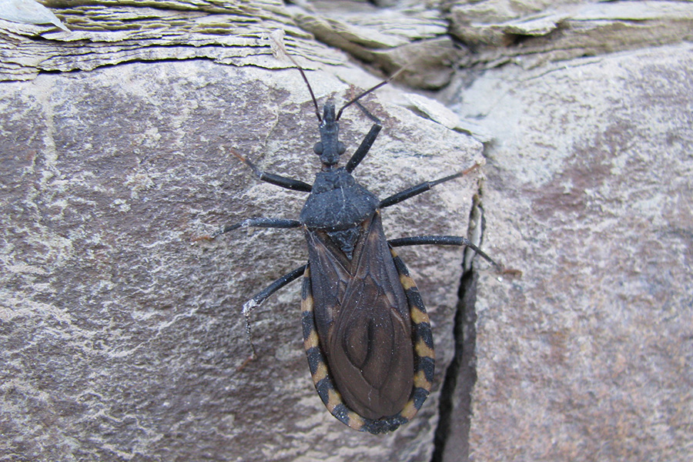
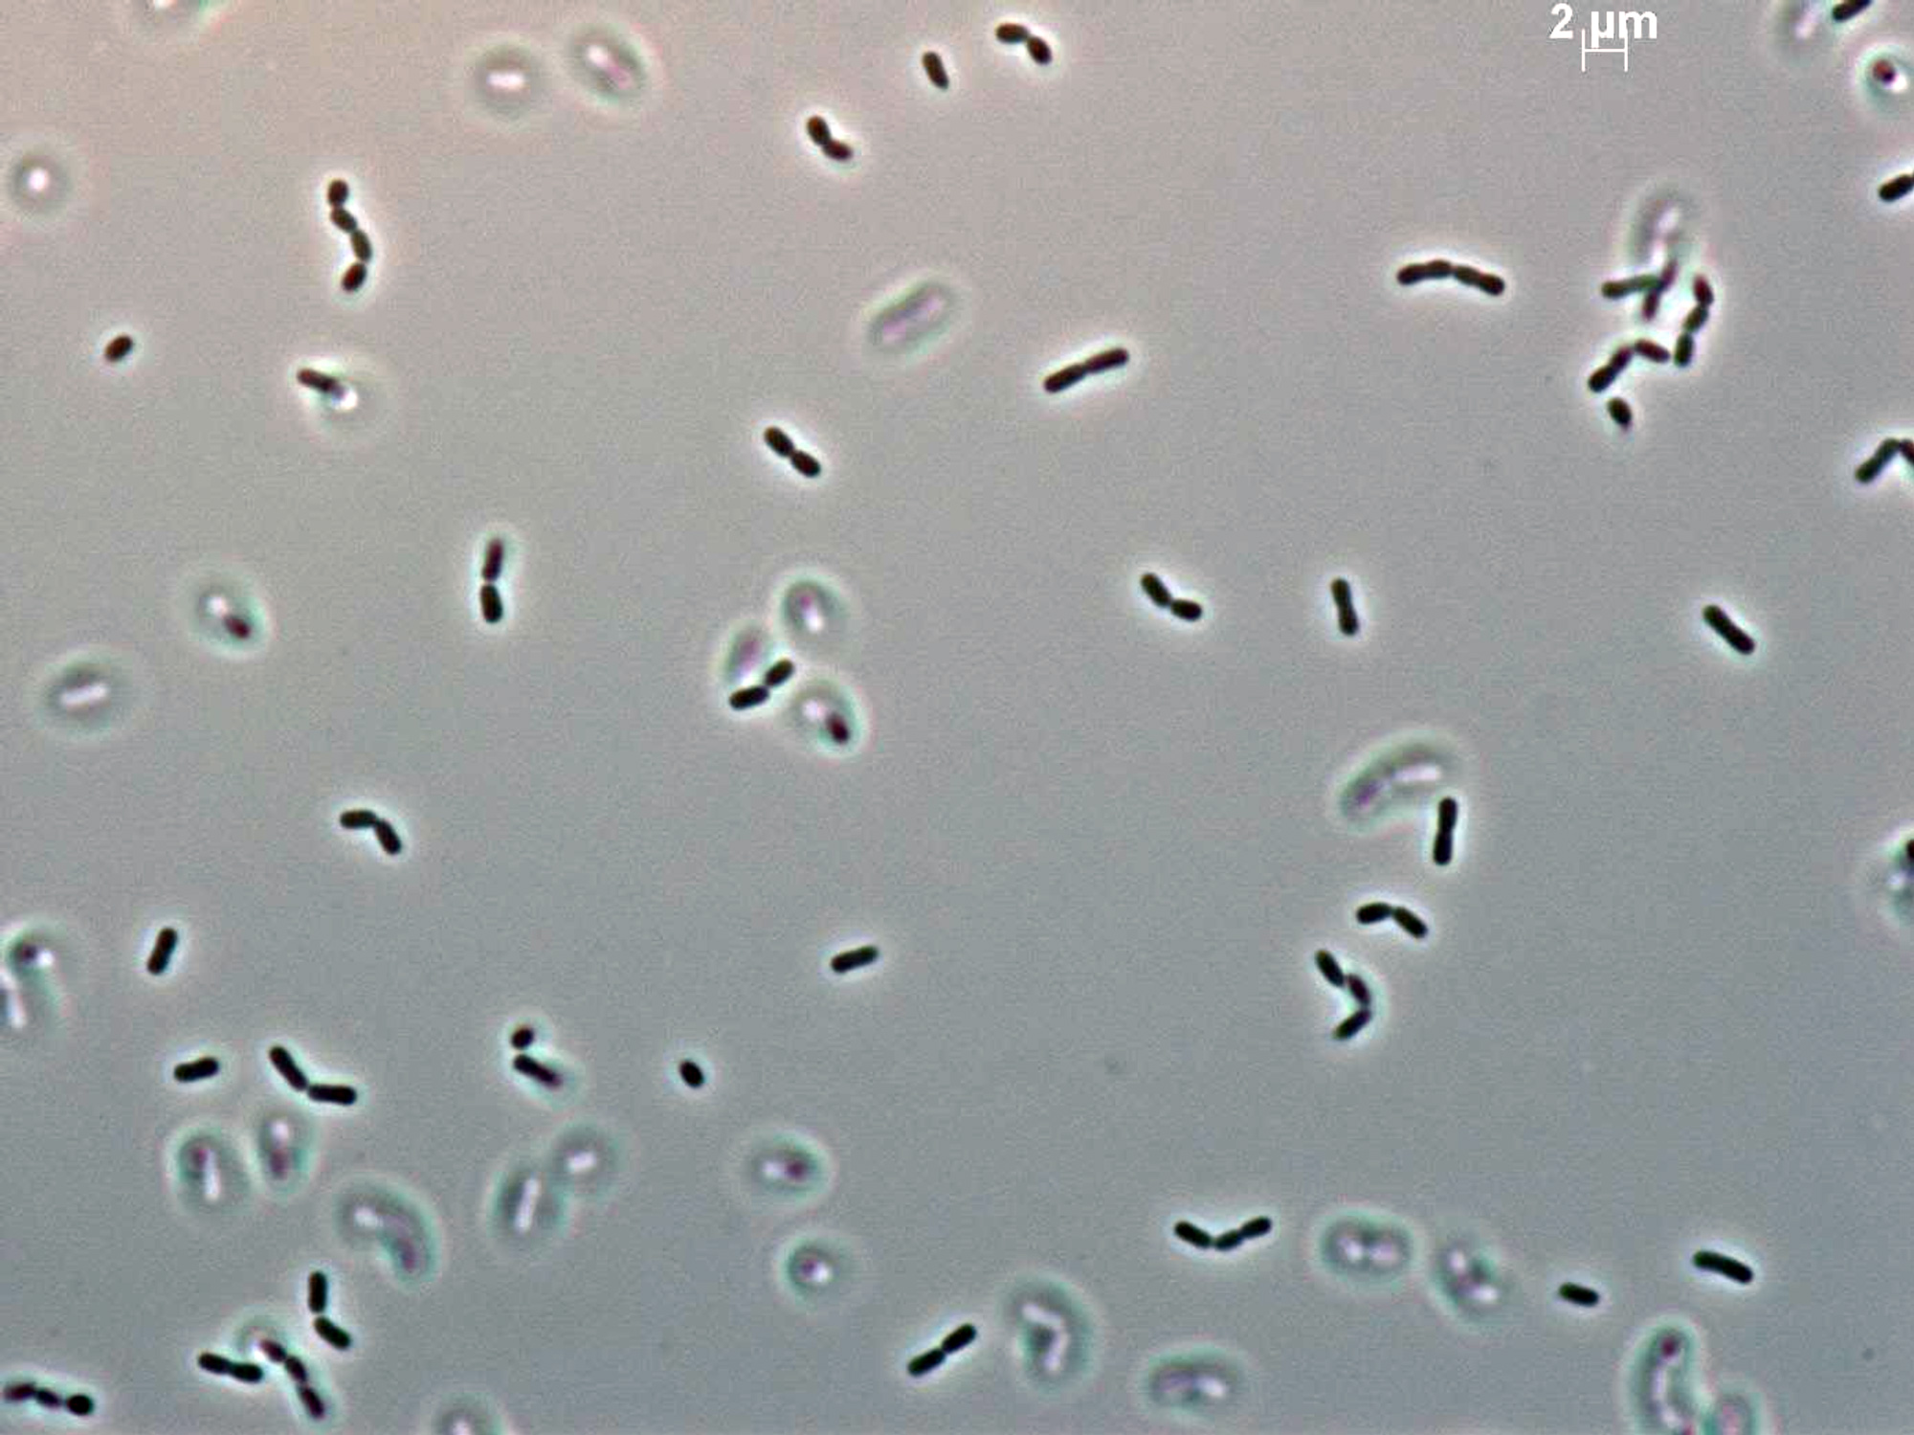
Featured health-related datasets and publishers
Mosquito Alert
Institute of Tropical Medicine Antwerp
CEPAVE: Centro de Estudios Parasitológicos y de Vectores
Bacteria in domestic water-storage containers with or without mosquito larvae
Notes:
Notes

Slide 7
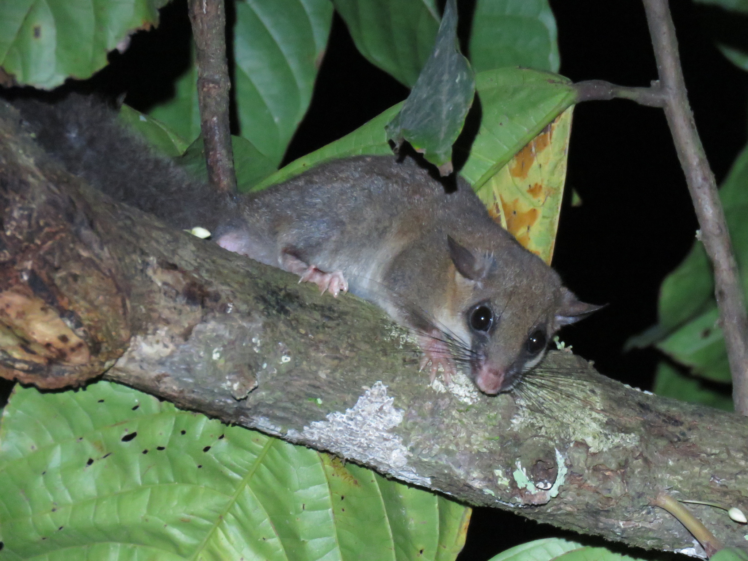
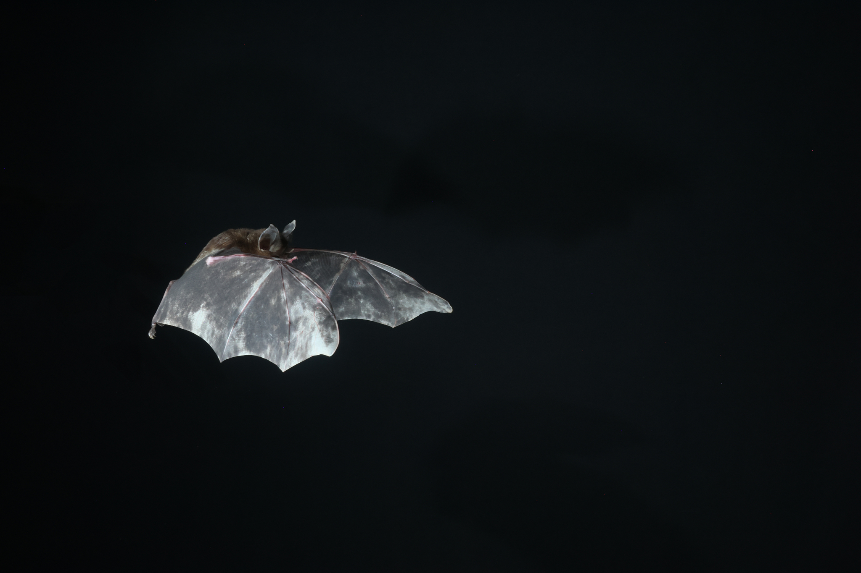
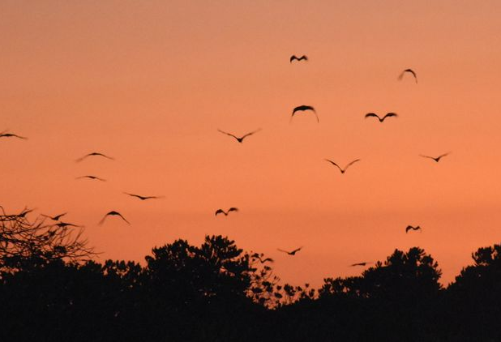
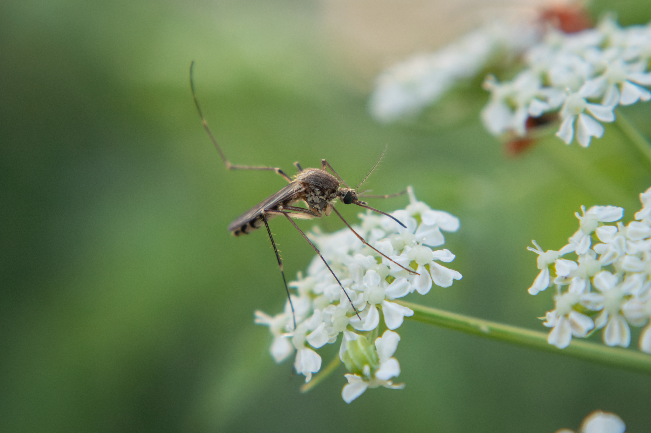
Featured data uses in human health-related research
Mapping global zoonotic and interregional transmission of mpox
Climate change brings bat hosts of SARS-like viruses closer to humans
Beyond the tipping point for cross-species viral transmission risk
Climate change expands future ranges of arbovirus vectors
Notes:
Notes

Slide 8
Health
Learn more!

